Slide 1
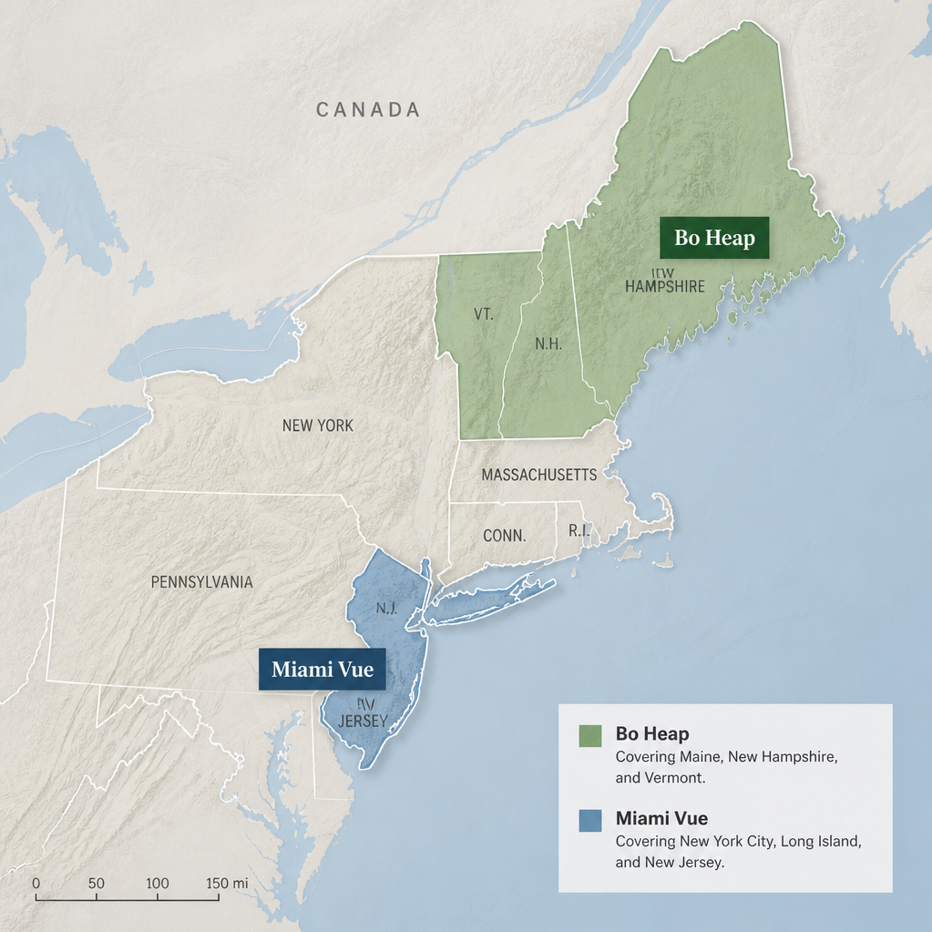
EmporiUm Northeast Territory Analysis
Miami Vue vs Bo Heap
Cagla Celik
Year Up United Data Analyst Training Academy

Slide 2



Project Overview & Objectives
Analyzing EmporiUm's Northeast Sales Territories for Next Quarter, 2026 Marketing Strategy
Project Goal
Key Objectives
Tools Used
To analyze EmporiUm's Northeast sales territories and drive strategic marketing.
Compare territory sales, identify top stores, analyze customer and product trends, and recommend a new marketing strategy.
Python (Pandas, NumPy, Matplotlib) and Jupyter Notebook were utilized for the analysis.

Slide 3


Territory Snapshot
Miami Vue
Bo Heap
Territory Manager — Northeast
Territory Manager — Northeast
16
New Jersey Stores
18
Massachusetts Stores
$5.17M
Total Revenue (2022–2025)
$5.73M
Total Revenue (2022–2025)
38,195
Transactions
42,010
Transactions
$1.87M
Revenue in 2025 alone
$2.13M
Revenue in 2025 alone
Region Director:
Michael Jarvis
Region Director:
Michael Jarvis
Both territories operate within the same Northeast region, making this a direct, like-for-like performance comparison.

Slide 4
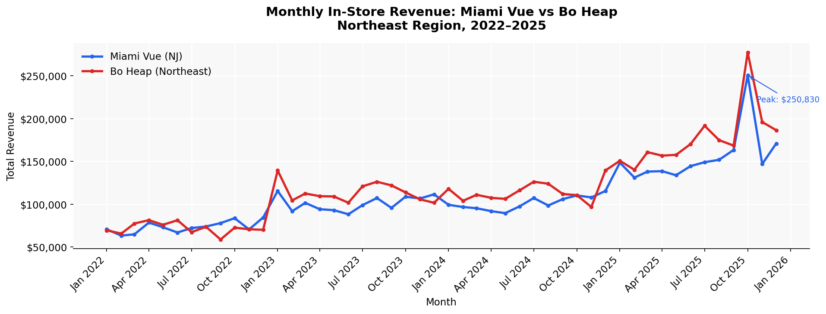
Monthly Revenue Trends Miami Vue vs Bo Heap
Northeast Region : January 2022 - September 2025
Overall upward revenue trend for both territories, with Miami Vue doubling its revenue by 2025 and peak sales observed in late 2025, indicating consistent positive long-term growth.

Slide 5
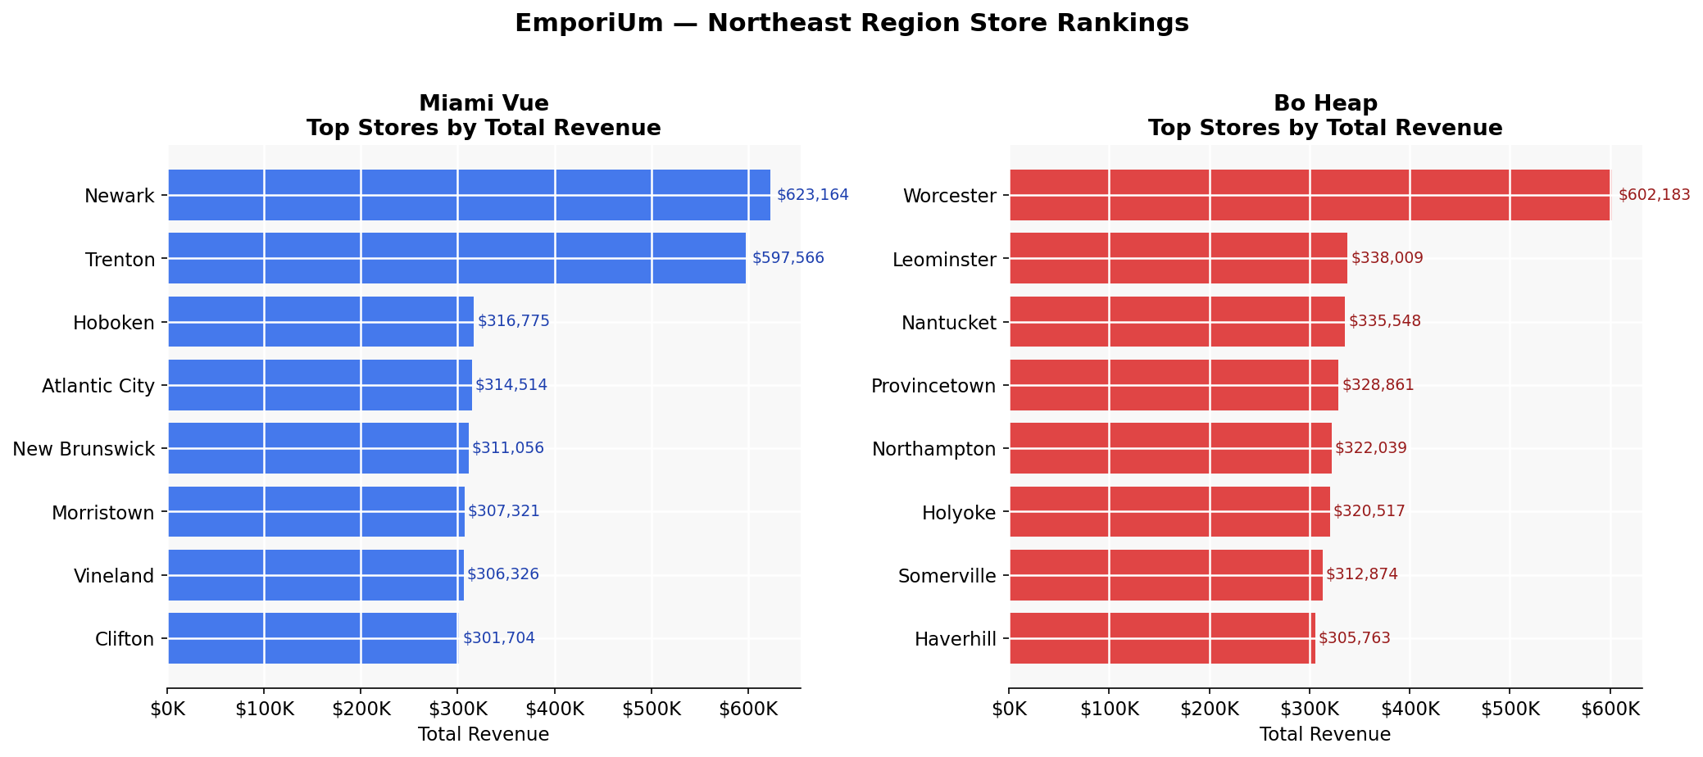
Store Performance Rankings
Top Stores by Territory
Miami Vue leads in sales for Newark and Trenton. Paterson requires investigation due to inactivity.

Slide 6
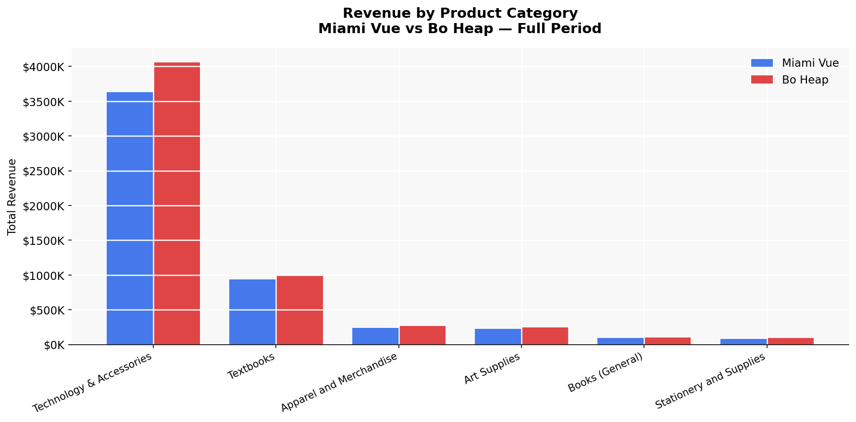
Product Category Insights
Performance Overview - Revenue by Product
Technology & Accessories drives revenue and exhibits stronger long-term growth, while Textbooks show stable seasonality.

Slide 7

2026 Marketing Recommendations
Strategic Imperatives for Growth
Focus on Technology & Accessories
Investigate Transaction Halt
Enhance Customer Acquisition
Pilot Targeted Campaigns
Direct marketing campaigns towards the Technology & Accessories category.
Examine the cause of the transaction halt at the Paterson store.
Expand rewards membership to boost new customer acquisition.
Launch experimental campaigns in high-performing stores: Newark and Trenton.

